Slide 1
U.S. SUPREME COURT: YEAR IN REVIEW AND YEAR AHEAD
Gregory E. Maggs
Professor of Law & Co-Director, National Security Law LL.M. Program, The George Washington University Law School
Military Judge (Reserve), U.S. Army’s 1st Judicial Circuit

Slide 2
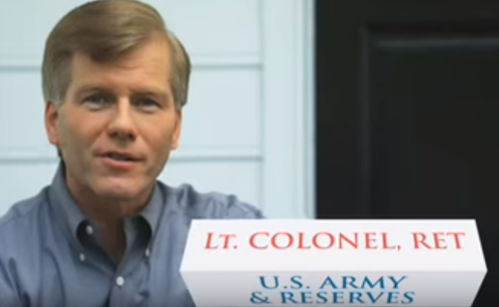
McDonnell v. United States 136 S. Ct. 2355 (2016)
Under 18 U.S.C. § 201(b)(2)(A), "the Government was required to show that Governor McDonnell committed an 'official act' in exchange for the loans and gifts. . . . [S]etting up a meeting, calling another public official, or hosting an event does not, standing alone, qualify as an 'official act' [as defined in § 201(a)(3)]."
Notes:
Tip: Add your own speaker notes here.

Slide 3
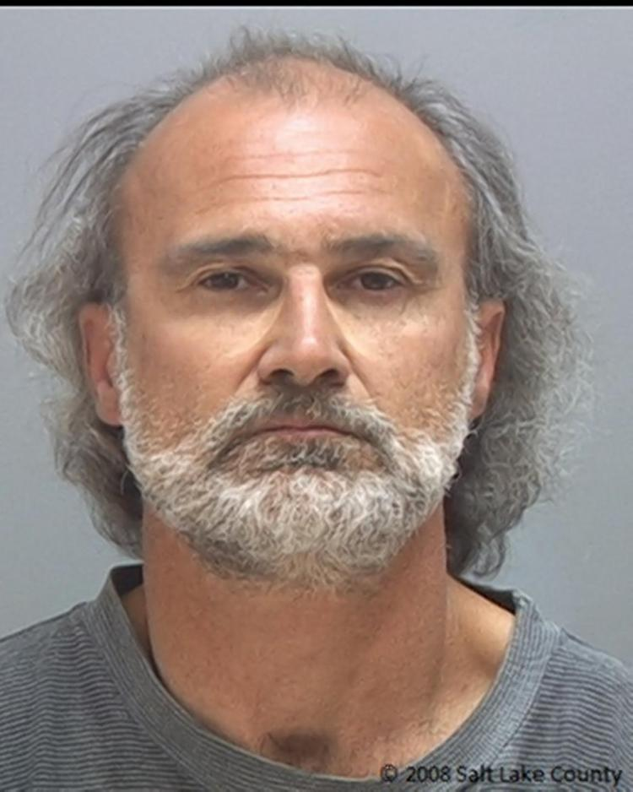
Utah v. Strieff 136 S. Ct. 2056 (2016)
"[E]vidence discovered on Strieff's person was admissible because the unlawful stop was sufficiently attenuated by [a] pre-existing arrest warrant. . . . The discovery of that warrant broke the causal chain . . . . And, it is especially significant that there is no evidence that [the] illegal stop reflected flagrantly unlawful police misconduct."
Justice Kagan’s translation: "So long as the target is one of the many millions of people in this country with an outstanding arrest warrant, anything the officer finds in a search is fair game for use in a criminal prosecution."

Slide 4
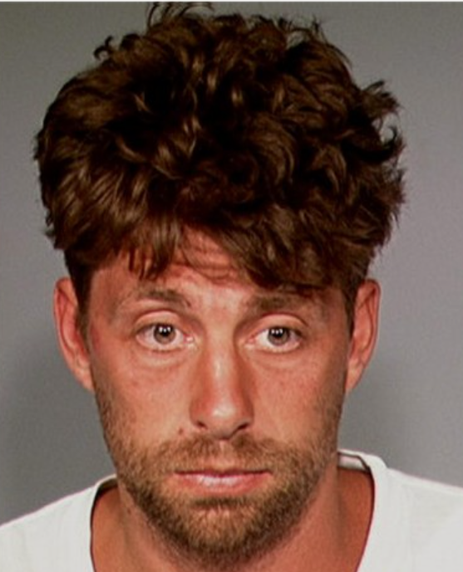
Birchfield v. North Dakota 136 S. Ct. 2160 (2016)
"[T]he Fourth Amendment permits warrantless breath tests incident to arrests for drunk driving. The impact of breath tests on privacy is slight, and the need for . . . testing is great. We reach a different conclusion with respect to blood tests. Blood tests are significantly more intrusive, and their reasonableness must be judged in light of the availability of the less invasive alternative of a breath test.

Slide 5
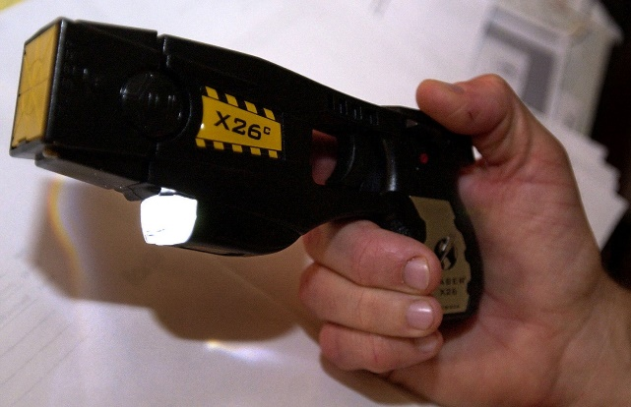
Caetano v. Massachusetts 136 S. Ct. 1027 (2016)
"The court offered three explanations to support its holding that the Second Amendment does not extend to stun guns. First, . . . stun guns 'were not in common use at the time of the Second Amendment's enactment.' . . . [Second,] stun guns are "dangerous per se at common law and unusual' . . . . Finally, the court . . . found 'nothing in the record to suggest that [stun guns] are readily adaptable to use in the military.' . . . [This reasoning] . . . contradicts this Court's precedent."

Slide 6
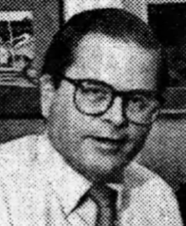
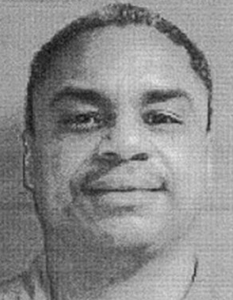
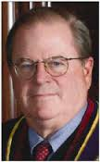
Williams v. Pennsylvania 136 S. Ct. 1899 (2016)
"One of the justices on the State Supreme Court had been the district attorney who gave his official approval to seek the death penalty in the prisoner's case. * * * The involvement of multiple actors and the passage of time do not relieve the former prosecutor of the duty to withdraw in order to ensure the neutrality of the judicial process in determining the consequences that his . . . earlier, critical decision may have set in motion."

Slide 7
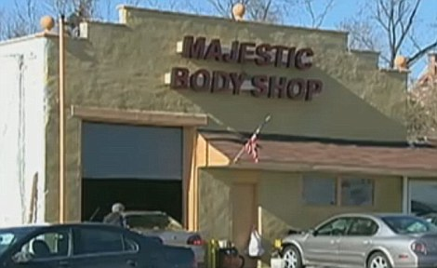
Ocasio v. United States 136 S. Ct. 1423 (2016)
"A defendant may be convicted of conspiring to violate the Hobbs Act [i.e. extortion] based on proof that he reached an agreement with the owner of the property in question to obtain that property under color of official right."

Slide 8
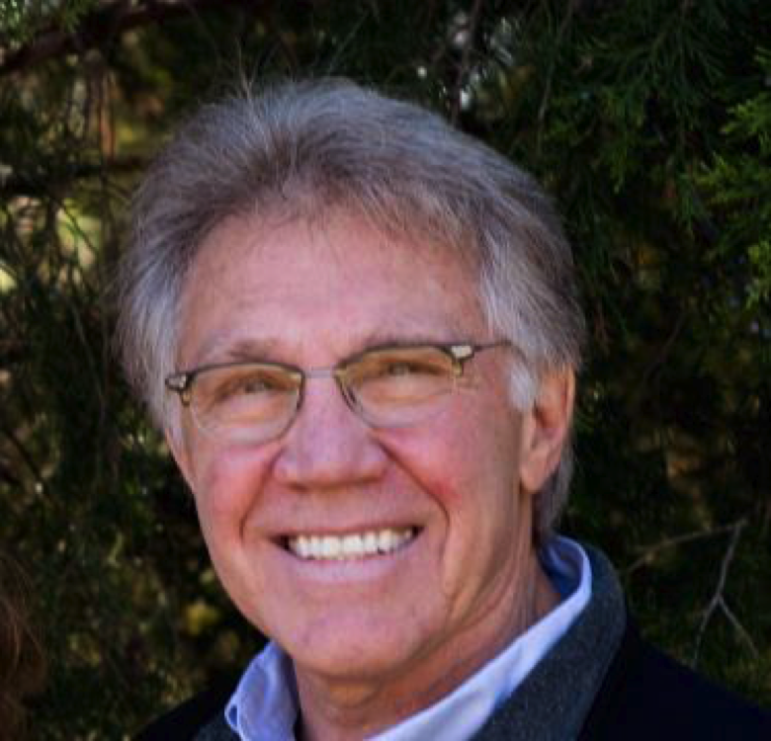
Musacchio v. United States 136 S. Ct. 709 (2016)
"[W]hen a jury instruction sets forth all the elements of the charged crime but incorrectly adds one more element, a sufficiency challenge should be assessed against the elements of the charged crime, not against the erroneously heightened command in the jury instruction."

Slide 9
Betterman v. Montana 136 S. Ct. 1609 (2016)
"We hold that the [Sixth Amendment's Speedy Trial] guarantee . . . does not apply once a defendant has been found guilty at trial or has pleaded guilty to criminal charges. For inordinate delay in sentencing . . . a defendant may have other recourse, including, in appropriate circumstances, . . . relief under the Due Process Clauses of the Fifth and Fourteenth Amendments. "
April 19, 2012 - pleaded guilty to bail jumping
June 27, 2013 - sentenced to seven years

Slide 10
October 2016 Term: Outlook
Justice Scalia’s Vacancy
Death Penalty
Criminal Law Cases

Slide 11
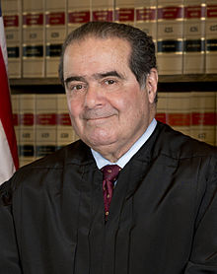
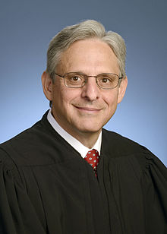
Antonin Scalia
1936-2016
Merrick Garland

Slide 12
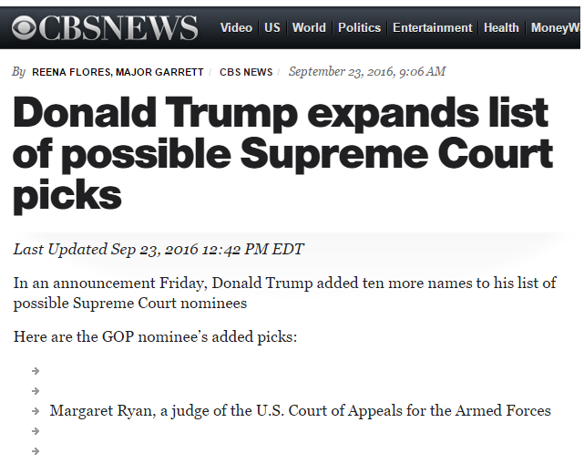
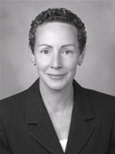

Slide 13
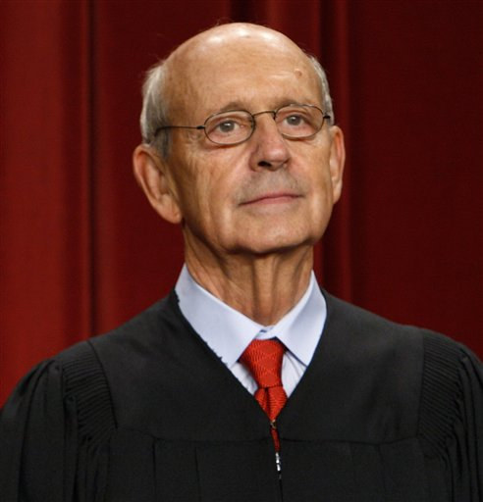
"Nearly 40 years ago, this Court upheld the death penalty under statutes that, in the Court's view, contained safeguards sufficient to ensure that the penalty would be applied reliably and not arbitrarily. . . . The circumstances and the evidence of the death penalty's application have changed radically since then. Given those changes, I believe that it is now time to reopen the question." Justice Breyer, dissenting in Gosslip v. Gross (2016)
"[T]here was no movement on Justice Stephen G. Breyer's call last year to re-examine the constitutionality of the Death Penalty." Lance Rogers,Term in Review, U.S. Law Week (2016)

Slide 14
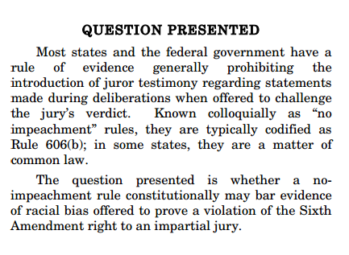
Forty cases already granted for October 2016 Term
Only six involve criminal law
Possibly the most far reaching: Pena-Rodriguez v. Colorado

