Slide 1

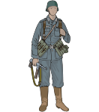
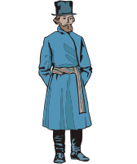
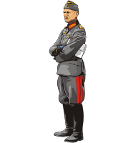
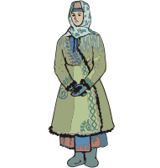
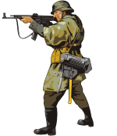

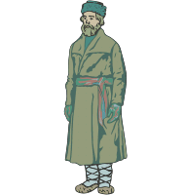


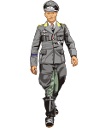



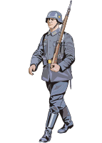
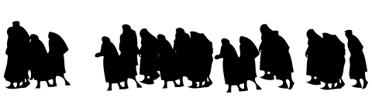
Wehrmacht Participation in Mass Killing
Shooting
Round-up
Outer Cordon
Cordon
Escorting
Cordon
Notes:
The killing was both organized and intimate.
Zimber apparently stationed himself at the execution site, and oversaw the pairing of two German soldiers to each Jew for the actual execution.
Interestingly, the organization of the executions allowed certain soldiers to request of 1SG Zimber that they be allowed to avoid the shooting detail.
One soldier, Wilhelm Magel, found himself paired with a sergeant who had a doctorate in theology. As they were moving to the execution site, they discussed how they might avoid the detail. At the site, the theologian asked Zimber if they could be relieved from the shooting detail. Zimber agreed they could return to the guard detail as soon as two other soldiers came. When the pair was directed to fire at their assigned civilian, they both aimed away when they shot, leaving the civilian unharmed. Zimber ordered a local policeman to shoot the Jew, and the pair returned to the square.
Another soldier, Sergeant Winter, had apparently found out about the detail in advance, and approached Zimber and asked to be relieved from the shooting detail, stating, that it wasn’t his thing, and chillingly, “there were enough people who would do this voluntarily. “ Zimber released him from the detail.
In total, 114 Jews, including women, children and elderly men, were executed. They were haphazardly buried, and then locals pillaged their homes.
After the executions, the platoon was in a somber mood. Many of the soldiers did not agree with what they had just done, but others justified it as being necessary to deal with the partisans. Regardless of their positions on the executions, one soldier noted something that they all had in common – no one talked about what he personally had done.

Slide 2
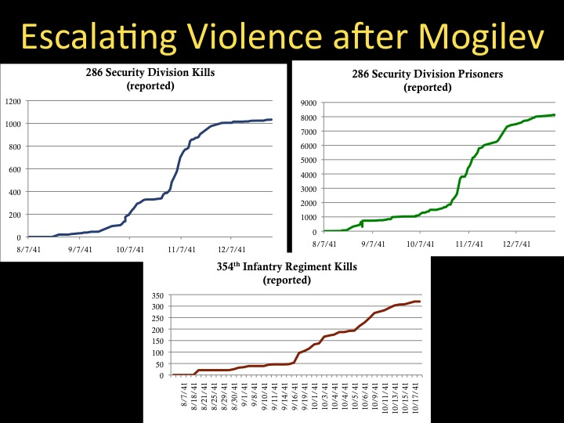
Escalation

Slide 3
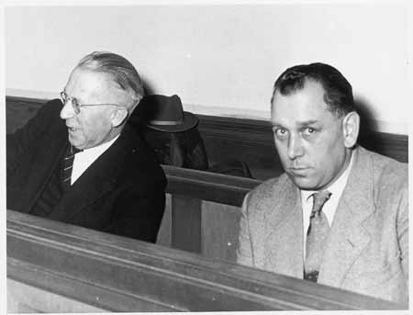
People v. Nöll & Zimber (1956)
● On General Appeal, Accessory to Manslaughter Verdicts Confirmed, Sentences Reduced
● Court Agrees MAJ Commichau Ordered an Excessive Reprisal, Not Murder because They were Jews
Complete Annihilation of Group Was Not Required by Military Necessity; so this was Only Manslaughter
Nöll & Zimber in Darmstadt Court
Notes:
Noll, Zimber and Wilhelm Magel (the soldier who purposefully didn’t shoot straight), were tried in a Darmstadt court after the war for their alleged roles in the execution of the Jews of Krucha. Magel was acquitted, and Noll and Zimber were convicted of being accessories to manslaughter, not murder.
Commichau had been killed in 1944, and was not there to speak for himself. However, the Appeals court found that when he gave the order to kill the Jews, the weight of evidence showed that his order was not based on their religion but on their support of the partisans. He therefore did not have the specific intent to kill the Jews on the basis of a “base motive,” and therefore did not commit murder.
Because the law of armed conflict at that time allowed reprisals to be taken against innocent civilians to deter partisans, Commichau’s crime was not in ordering the killings, but in not specifying that it should be restricted to those who were capable of supporting partisans.
Noll and Zimber should have known that killing all the Jews was not legal, and under the Military Penal Code should have not carried out the order in its entirety. The Appeals court found extenuating circumstances, and reduced Noll’s sentence from 4 to 3 years, and Zimber’s from 3 to 2. It also chastised Noll, which it described as “unheroic,” for being a substandard officer and forcing 1SG Zimber to carry out the executions.
This approach, this precise finding that the intentional killings of unarmed civilians in excess of that permitted by the law of armed conflict was manslaughter and not murder, does not square even with the war crimes trials by the German Supreme Court after WWI at Leipzig, which were incredibly lenient. It is a fair representation of the way in which the domestic West German courts handled war crimes cases in the 1950’s and 1960’s.

Slide 4
Orders are Orders – Or Are They?
● Similar Life Experiences -- Both Nӧll and Sibille were World War I Veterans, Both Teachers, Both Nazi Party Members, Both had Families
● Same Level of Unit Command; Same Operational Experiences in this World War
● Different Moral Compasses? Different Values of Unit Loyalty?
● Different Values of Professionalism? Did the Mogilev Conference have an impact on their Decision-Making?
● What Happened to Sibille after He Refused the Order?

Slide 5
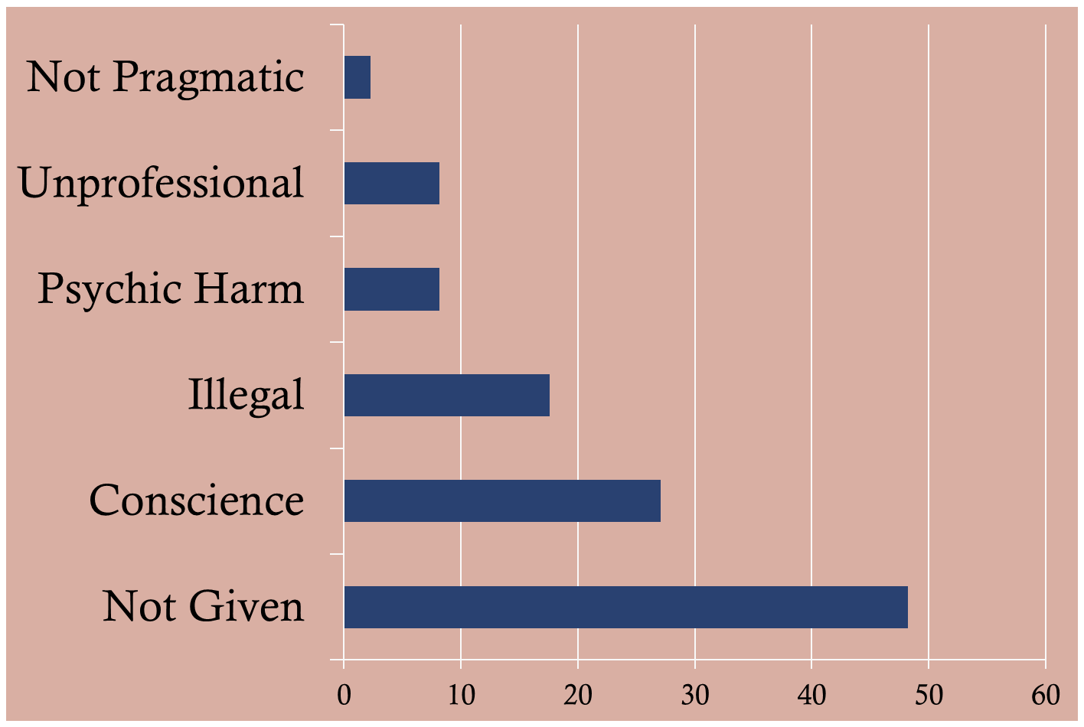
Those Who Said “No” -- Why
David H. Kitterman, Those Who Said “No!”, 11 German Studies Review, 248-49 (1988)
Notes:
Prof. David Kitterman reviewed the files of 85 instances of troops and policeman refusing orders to kill civilians or POWs. Percentage-wise, here is how the reasoning behind saying “no” sorted out. Almost half gave no reason for saying no, and about a quarter said they said no because of concerns of conscience, either philosophical or religious.
In the sample of 85 documented cases that Kitterman reviewed, only one individual seems to have suffered any real consequences. In November 1941, 1LT Nikolaus Hornig refused an order to shoot 780 Soviet POWs. He didn’t just say no, however, he gathered his troops together and told them that he objected on religious grounds and because it was illegal. He was later tried before SS and Police Courts, and sentenced eventually to 7 years, not so much for refusal as for “sapping the morale of his troops”. Although he was detained in Buchenwald, Himmler never approved his sentence, so he kept his uniform and continued to be paid, until he was liberated with the rest of the camp by the Allies.
Why did so many comply?

Slide 6
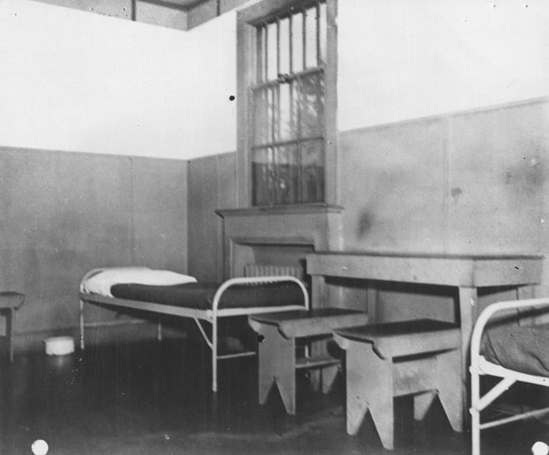
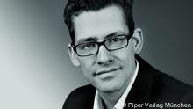
Those Who Did Not Say “No”
A POW room at the Joint Interrogation Center at Fort Hunt, VA
Notes:
The recently published work by historian Felix Roemer perhaps sheds some light on this. His research team reviewed transcripts of secretly recorded conversations between thousands of German soldiers held by the U.S. Army at Fort Hunt, Virginal. In contrast to the soldiers’ statements that make the Noell and Zimber case such a rich source of information for what soldiers did and thought at the time the atrocities were committed, these conversations were recorded between 1942 and 1945 – prior to any trials being held, and while memories were likely still fresher.
Among his team’s findings:
Soldiers who had not participated in atrocities against Jews were more likely to criticize them; those who had were more likely to justify them.
The soldiers reflected a significant degree of Nazi politicization within the lower levels of the Wehrmacht.
Amongst themselves, rarely did they say they were only following orders. Much more important to them were their relationships with their fellow soldiers and leaders.

Slide 7
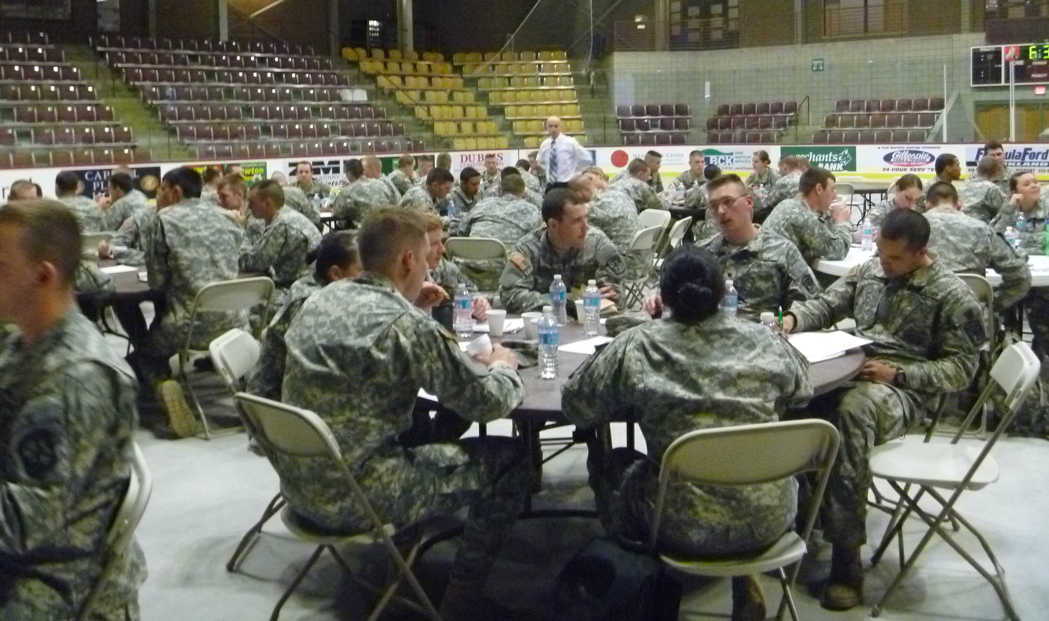
ROTC Cadets
Norwich University

Slide 8
Scenario
● Assume 1st BN was part of your BDE. Any Criminal Matters are already being handled.
● Your BDE CDR has appointed you as an AR 15-6 investigating officer to look into what happened with 1st BN and see if there are any Lessons to be Learned for Training Purposes.
● Specifically, BDE CDR wants to know:
► Which Facts do you Find Relevant to the Killings of the Civilians?
► What Standards were applied then, and what Standards should have been applied now by the 1st BN CDRs?
► What Conclusions do you draw from Applying the Standards to the Relevant Facts?
► What are your Recommendations?

Slide 9
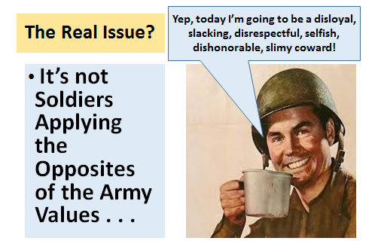
Ordinary Soldiers combined with SHARP Training

Slide 10
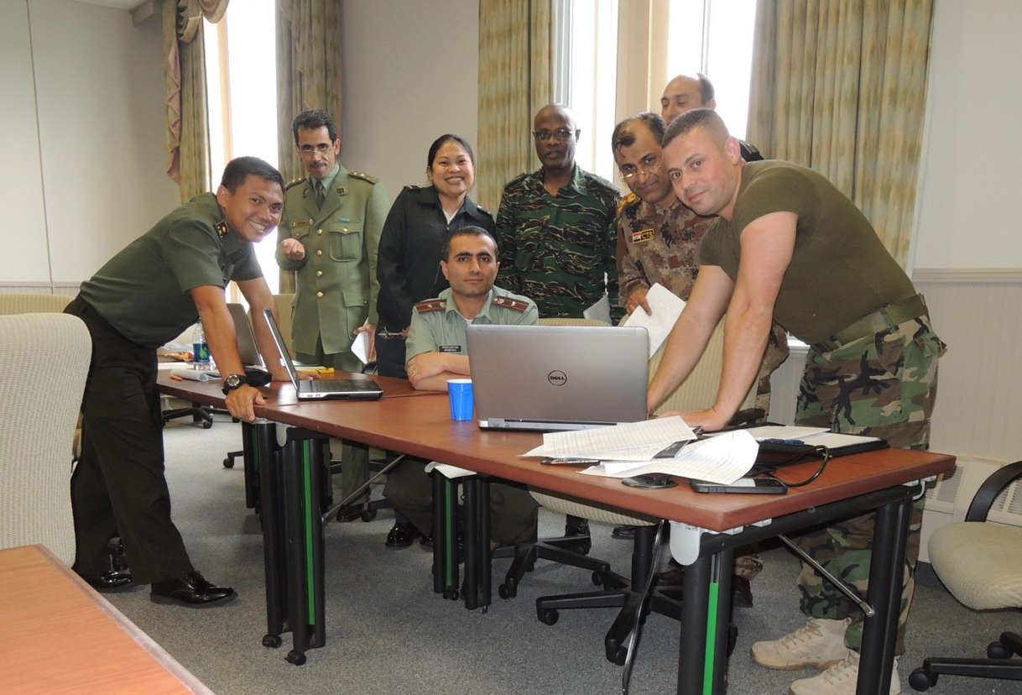
International Officers -- DIILS

Slide 11
Scenario
● You are part of a Multinational Headquarters Staff preparing for a Mission Authorized under Chapter VII by the UN.
● Commander wants to Ensure a Common Basic Training Plan for LOAC/ROE all TCNs.
● Commander has seen the Ordinary Soldiers lesson plan and wants you to Develop a Course of Action Sketch that Addresses the Command & Legal Issues Raised in It.
● Specifically Address:
► Overall Approach to Training Delivery
► Content Areas to be Covered
► Training Delivery Plan
► Certification Standards
► Challenges

Slide 12
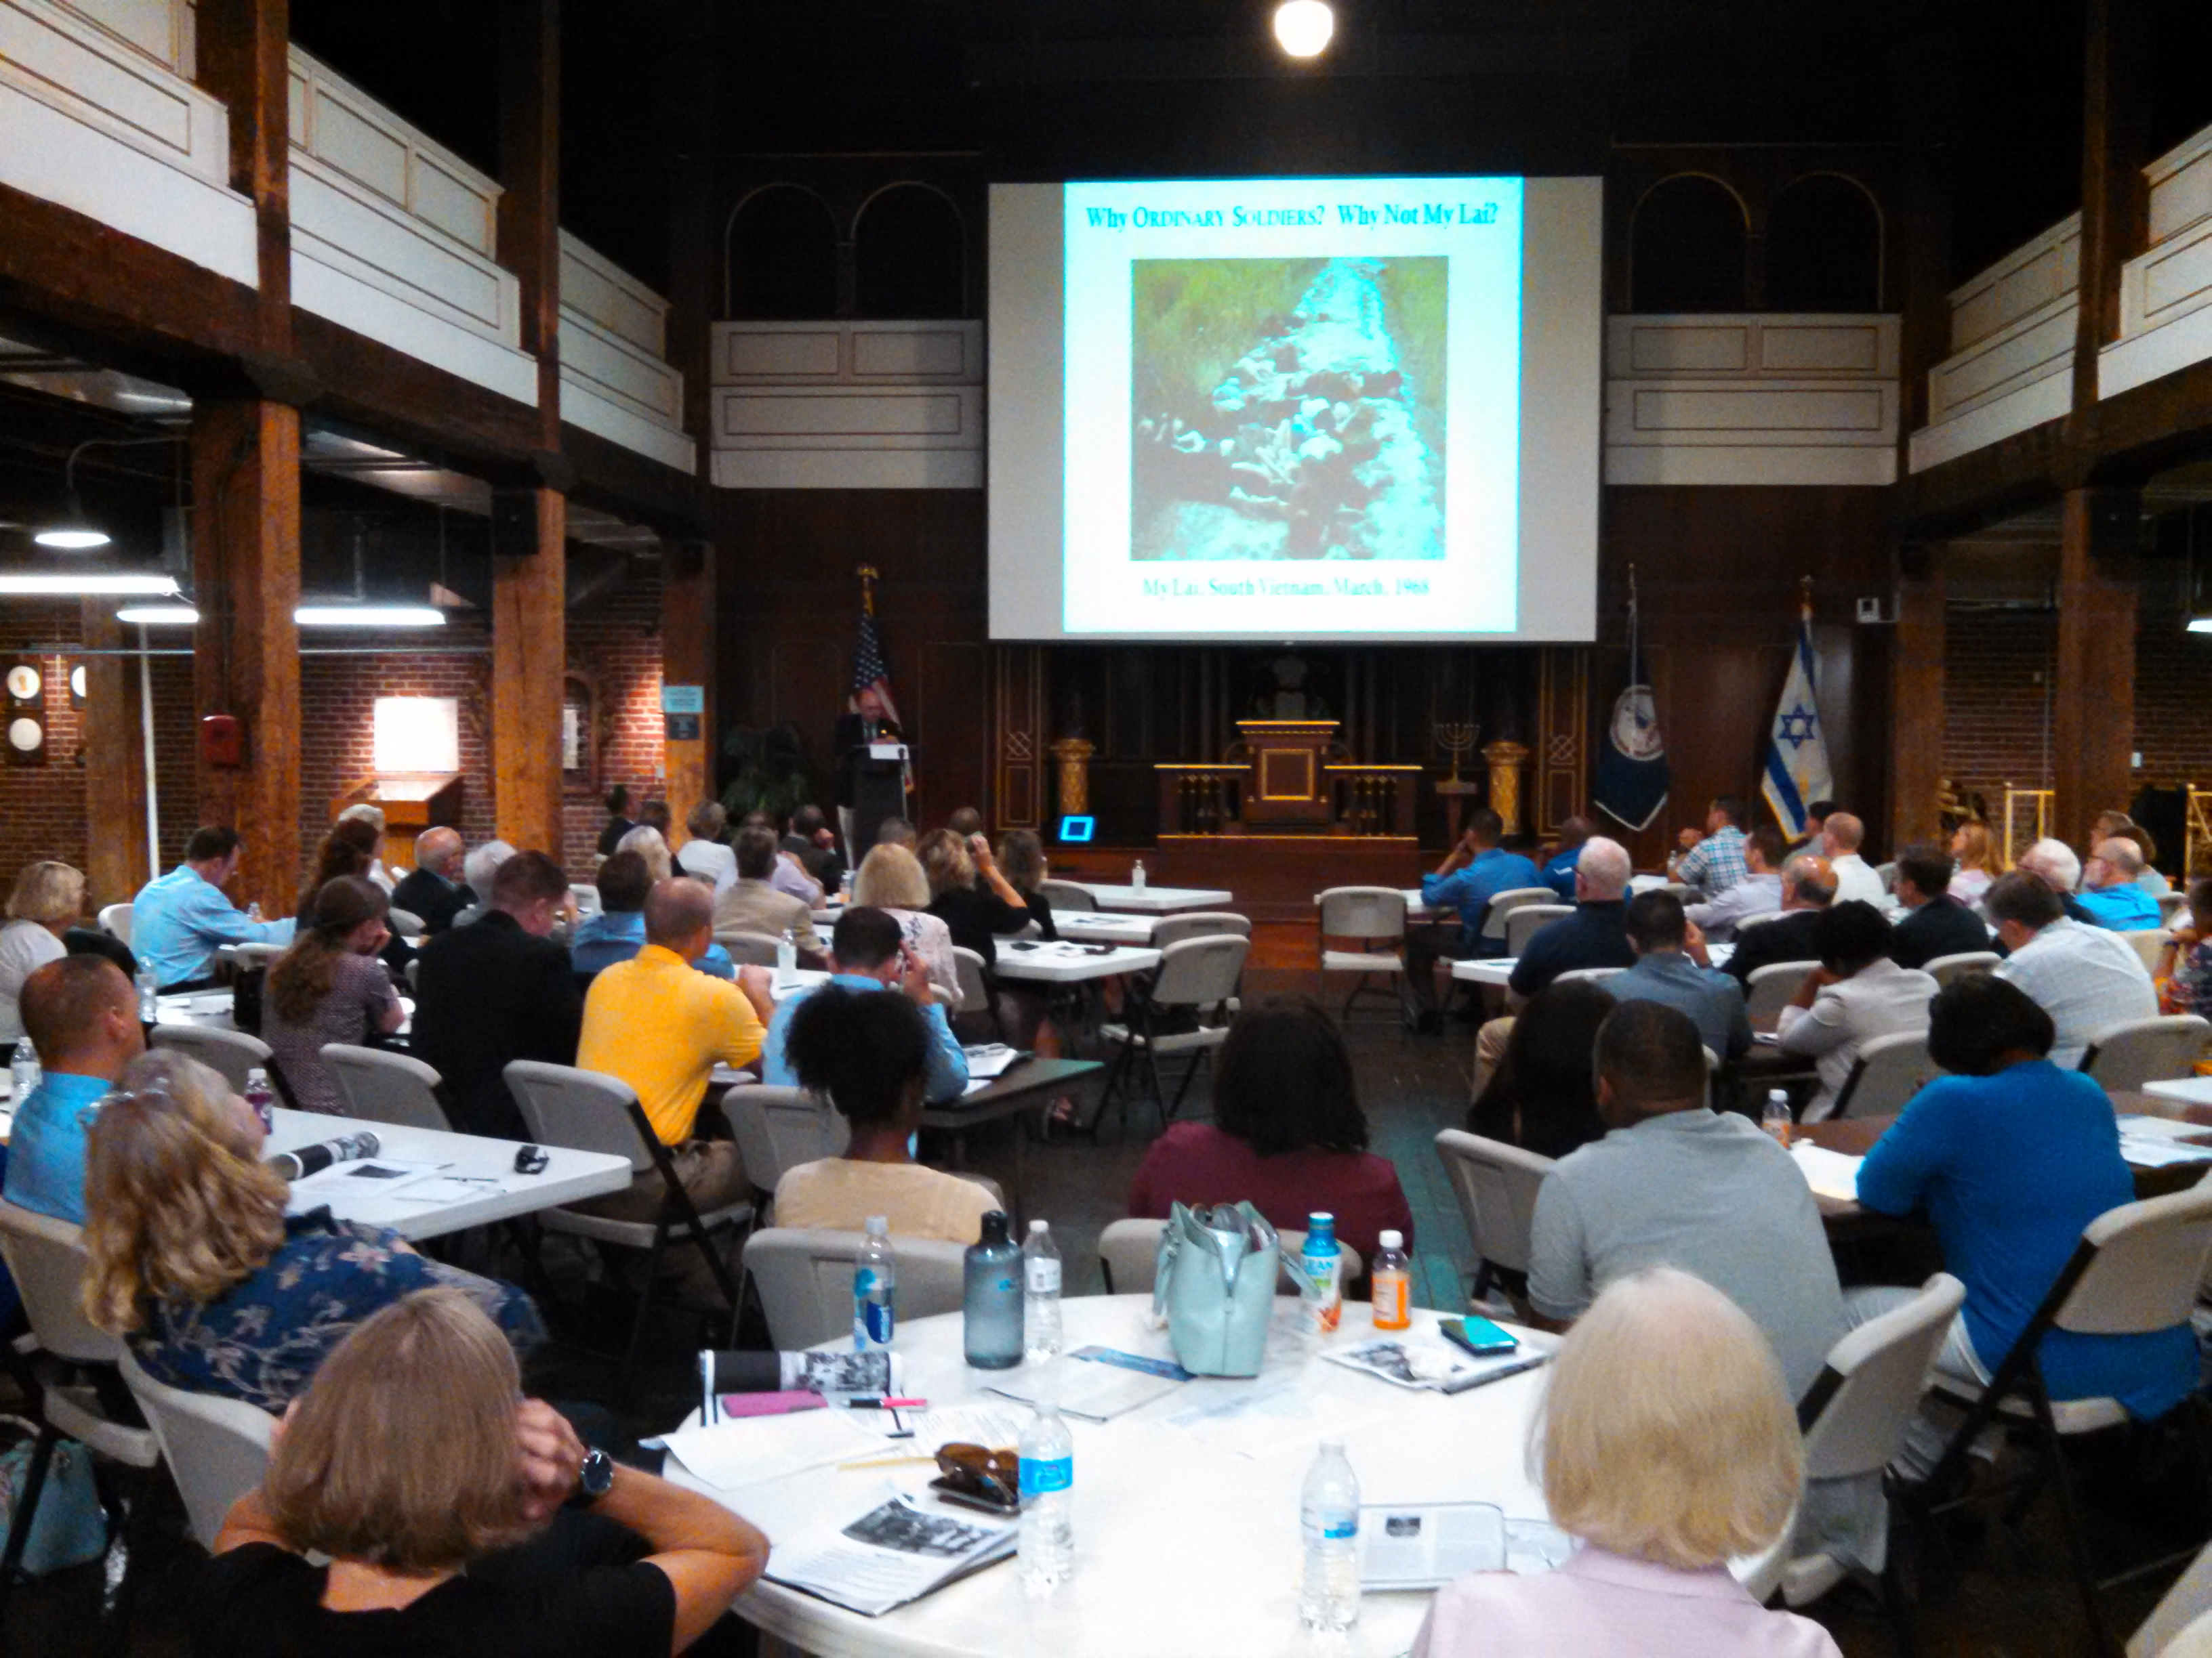
Virginia Bar

Slide 13
Scenario
● As attorneys, you have been appointed by the Commander of an Infantry Division to an Advisory Panel to look into the Case of 1st BN, 691st RGT.
● The Commander thinks it might have lessons for training the Division’s personnel in avoiding Civilian Casualties.
● The Commander would like to know:
► Which Facts do you Find Relevant to the Killings of the Civilians?
► What Standards were applied, or should have been applied, by the Respective Small Unit Commanders?
► What Conclusions do you draw from Applying the Standards to the Relevant Facts?
► What are your Recommendations? Suppose you could make just one?

Slide 14
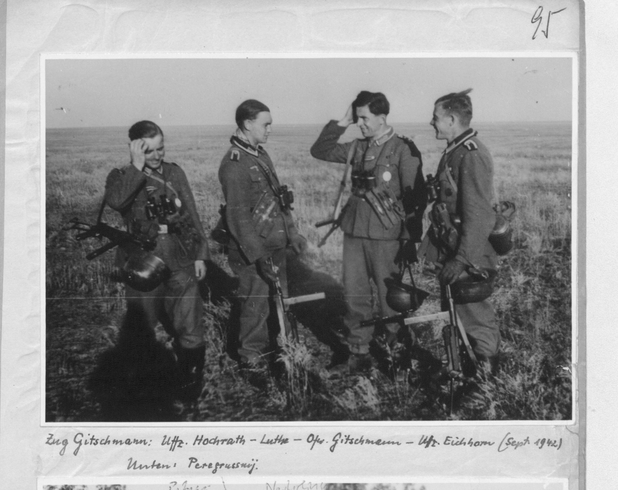
Ordinary Soldiers

