Slide 1
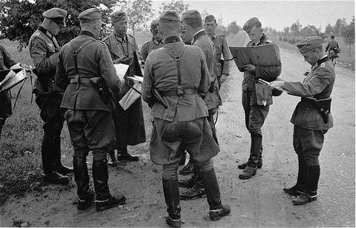
Turning Nürnberg Into Effective LOAC Education & Training
Ordinary Soldiers Project

Slide 2
My Goal?
● Values Based LOAC/ROE Training that is Realistic & Accessible . . .
● It Must be Collaborative – We are Social Animals . . .
● It Must Be Holistic . . .
● It Must Be Modular & Flexible . . .
● It Must Explore the Grey Area between Countervailing Positive Values

Slide 3
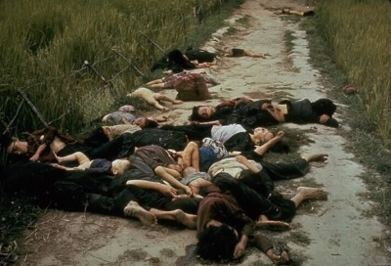
Why Ordinary Soldiers? Why Not My Lai?
My Lai, South Vietnam, March, 1968

Slide 4
Why Ordinary Soldiers?
● Operational Experiences of 1st BN, 691st IN Regiment
● Unit Demographics
● 1 Illegal Order – 3 Different Responses
● People v. Nӧll and Zimber (Darmstadt Regional Court, 1956)

Slide 5
1st BN, 691st RGT, 339th ID
● Originally a Static, Fortress Division – Mobilized Late 1940
● Loire Valley Occupation Duty, May-July 1941
● September 1941 Arrives Belarus, Rear Area Security Duty
● Very Little Enemy Contact Moving into Belarus
Notes:
What do we know about these soldiers? The division itself had originally been a static, fortress division. This meant that its equipment and its training were not as good as frontline units. Mobilized in 1940 at Jena, its first deployment was an occupation force in the Loire Valley after France surrendered. This deployment appears to have been fairly uneventful.
By the late summer of 1941, however, it was moving into the Army Group Center (Rear) AO to take up security duties.
As it took up its position, it experienced very little enemy contact. There were, however, bypassed Soviet units and troops roaming the swamps and forests, so there was some threat of enemy action.
The age demographics of the 691st RGT were very interesting. It was a very mature unit. Despite the fact that it had only one colonel and several lieutenant colonels, so fairly senior ranks, the average age of its officers was almost 40 years old. The average soldier was almost 30 years old.
This was not a front line unit. Although reliable statistics are difficult to come by, it would appear that the average soldier in the unit was between 4 and 6 years older than a typical front line soldier at this point in the war.

Slide 6
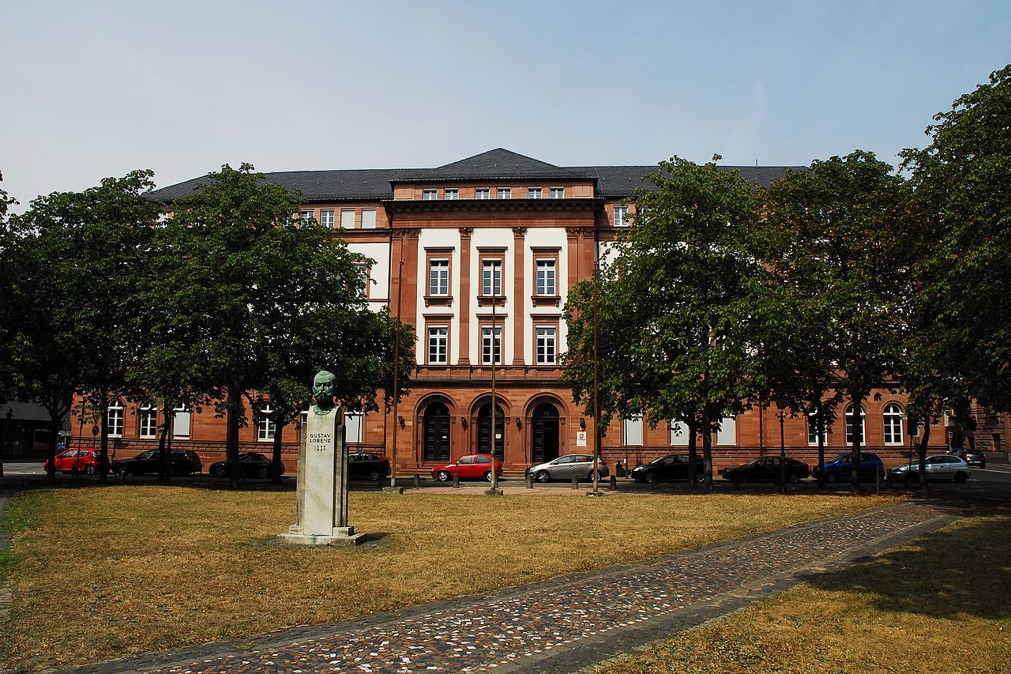
People v. Nӧll and Zimber
● Investigation began shortly after Military Occupation ended
● Civil Law System (Inquisitorial)
● 3 Learned, 2 Lay Judges
● Holistic Approach to Facts
Landgericht, Darmstadt

Slide 7
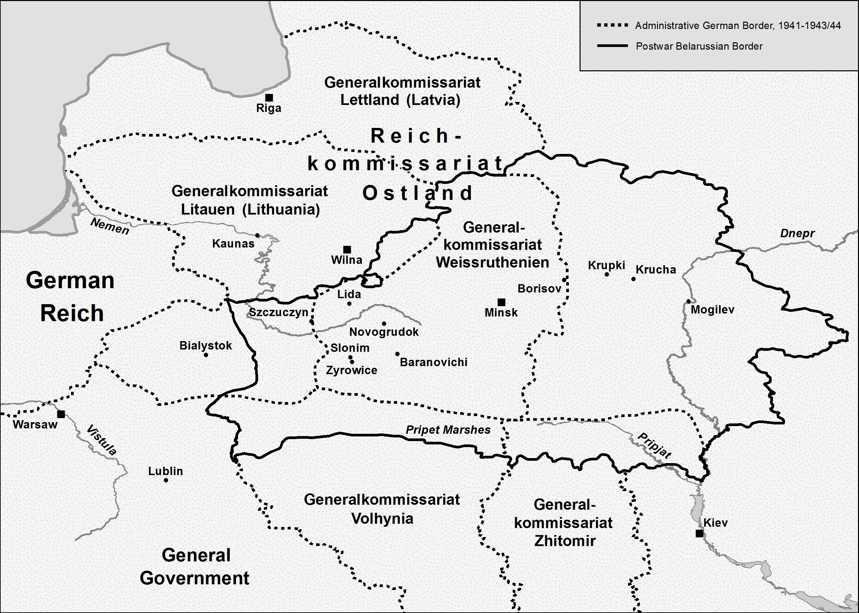

Slide 8
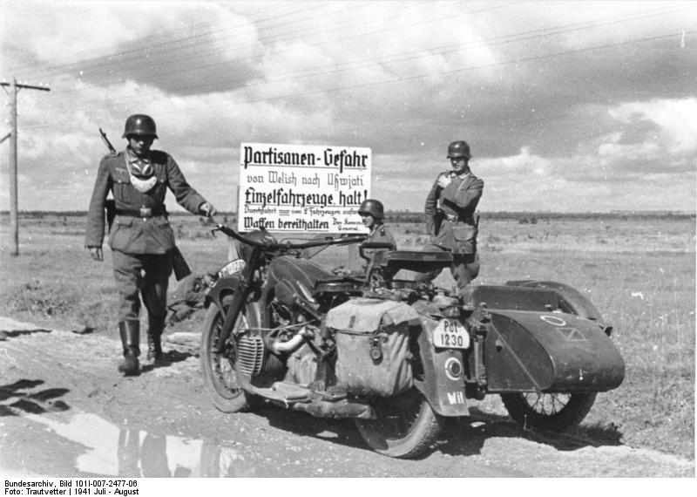
How Do Protected Civilians Become Military Targets?
Notes:
So, is there a process by which a generally disciplined national military force finds itself making civilians protected under international law military targets? This is exactly what happened in the Soviet Union after the Nazi invasion, through the conflation of the Nazi policy of Jewish extermination with one of the scariest monsters underneath the Wehrmacht’s bed at that time – Partisan warfare.
Not every Wehrmacht unit or soldier killed protected civilians, most probably did not. However, many did, and the Wehrmacht as an organization was deeply complicit in the Holocaust, for starters, through the provision of supplies and support to the Einsatzgruppen. Raul Hilberg explained this complicity, writing that “the generals eased themselves into this pose of cooperation through the pretense that the Jewish population was a group of Bolshevist diehards, who instigated, encouraged, and abetted the partisan behind German lines.”
This picture of a German military policeman at a traffic control point in the summer of 1941 shows the measures that the German military began implementing very early in the Russian campaign. German vehicles were required to stop and convoy up to be better able to fight off partisan attacks – and although there were sizeable numbers of bypassed Soviet units behind German lines because of the speed of the German advance, at this point in time partisan operations were at a nascent state at best.
Germany’s experience with partisans in the Franco-Prussian War, and to a lesser extent in WWI, colored its organization approach to partisan warfare. Captured partisans were not ordinarily given POW status, and were usually tried by courts-martial. Those found guilty of being unprivileged combatants were usually executed.

Slide 9
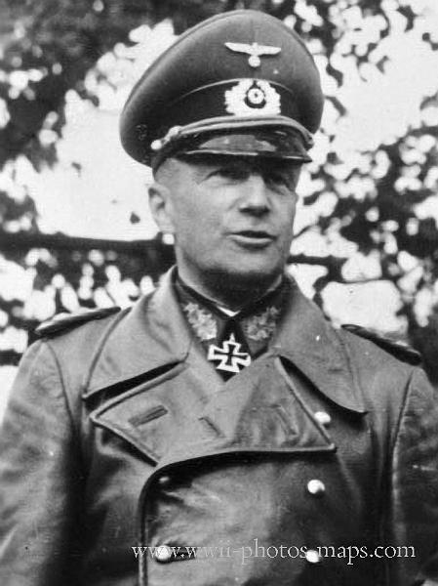
Barbarossa Jurisdiction Order
● Drafted by OKW Judge Advocate General Lehmann
● Partisans to be “Liquidated Ruthlessly”
● No Court-Martial of Suspects; Summary Decision by an Officer
● Crimes Against Civilians Not Prosecuted Unless Necessary for Discipline
After Complaints, OKH Commander von Brauchitsch “clarified”
Notes:
Barbarossa occasioned a number of implementing orders which sanctioned German brutality against the Soviet peoples and certain particular groups, such as the Commissar Order. For purposes of the lesson plan, the most important order to consider is the Jurisdiction Order.
Drafted by the senior military legal official, later convicted at Nuremberg, the Jurisdiction order radically changed the way military justice was to be administered with regard to captured partisans and Wehrmacht soldiers who abused civilians.
First, partisans were to be annihilated.
Second, those who were captured were not entitled to a trial – they were to be brought before even junior officers, one who had no court-martial convening authority, who would determine whether they should be shot.
Third, offenses committed against civilians would not be tried at court-martial unless it was necessary for maintenance of discipline. The example given was sexual offenses, which of course tracked Nazi racial theory.
Many German generals complained about the order, not so much because of its patent illegality and inhumanity in many cases, but because they feared this would basically give the soldiers a license to engage in criminal acts and cause a whole-scale break-down in discipline.
The Army commander therefore issued a supplement to the order which clarified that whether to prosecute was a commander’s decision on the basis of discipline.
Many were mollified, but some generals refused to transmit within their commands.
German soldiers were human – how do you turn off the kill switch when murder of civilians becomes the norm?

Slide 10
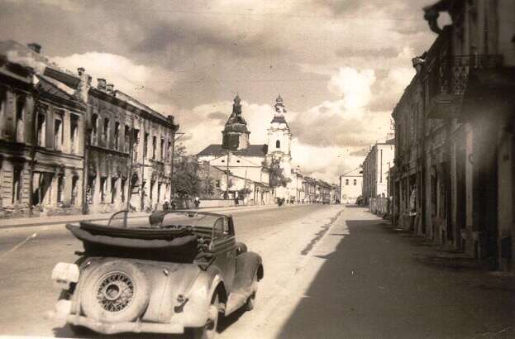
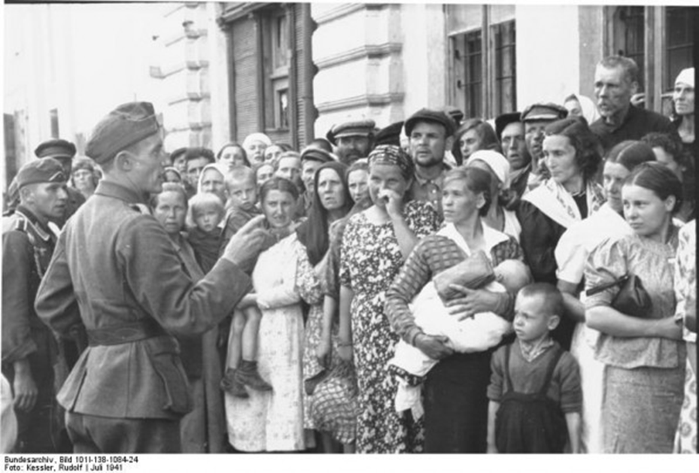
Mogilev, Belarus
Captured 26 July 1941 by Wehrmacht Units
Jewish Community Registered, Put in Ghetto, Killed by EG B
Notes:
As you know, the German advance through the Soviet Union in the summer of 1941 was rapid. By mid July German forces were moving through Belarus towards Moscow, and on 26 July they captured the city of Mogilev, which had a large and vibrant Jewish community.
The front line Wehrmacht units continued East, and Belarus became a rear area, a communications and supply train zone supporting the front.
Einsatzgruppe B was following in the wake of the front-line Wehrmacht units, and it moved into Mogilev. Jews in the Mogilev area were forced to register, pushed into a ghetto, and then exterminated by the SS. By late September 1941, there were few if any Jews left in Mogilev.
The area of operations was then organized as Army Group Center (Rear), commanded by General von Schenkendorff. The AO was enormous, with unevenly developed infrastructure, and vast areas of swamps and forests.
Rear area security units continued to flow into the AO, including the 1st BN, 691st RGt of the 339th Infantry Division.
Importantly for purposes of the case study, the Barbarossa Jurisdiction order was apparently in effect in Army Group Center (Rear).

Slide 11
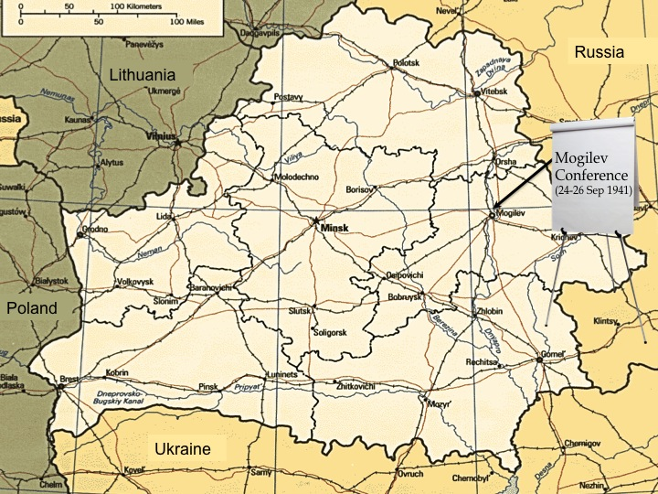
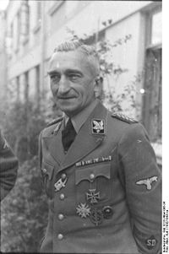
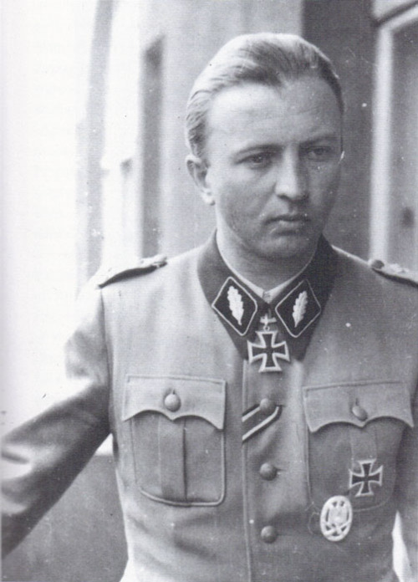
Jew = Partisan: The Mogilev Conference
SS-Brigadeführer Arthur Nebe (EG B)
SS- Gruppenführer Hermann Fegelein
(1st SS Cav. Rgt)
Attendees
SS-Obergruppenführer Erich v.d. Bach-Zelewski
(HSSPF, Mitte)
Notes:
Ostensibly for purposes of distributing lessons learned and tactics, techniques and procedures for fighting anti-partisan warfare, the Army Group Center (Rear) commander, General von Schenckendorff, convened a three day conference for subordinate unit commanders and unit representatives at his headquarters in Mogilev.
The vast majority of the attendees were Wehrmacht officers. There was a sizeable group of SS members in attendance as well. Senior SS commanders assumed a very significant role in the conference, and these were some bad actors.
A controversial figure, Arthur Nebe was the commander of Einsatzgruppe B, which as previously noted, had already exterminated the Jews of Mogilev. Part of the July 1944 plot against Hitler, Nebe was tried by the People’s Court and executed in 1945.
Hermann Fegelein commanded an SS cavalry brigade, and his troops were responsible for the deaths of over 11,000 people, mostly Jews, in 1941. He was executed for desertion two days before Hitler committed suicide.
Erich von dem Bach-Zelewski was in charge of anti-partisan operations in Belarus. Better known for his vicious suppression of the Warsaw Uprising in 1944, he was convicted and imprisoned after the war for his role in the Night of the Long Knives and killing Communists in the 1930s. He died in prison in 1972.

Slide 12
Conference – 24-26 Sep 1941
● rHGM Commander: The Elderly, Women and Adolescents support Partisans
● Bach-Zelewski & Fegelein: “Lessons Learned”
● Nebe: Cooperation with SS elements & “Jewish Question”
● Tactical Level Classes & Exercises
● Village Search Demonstration by Police & SD – No Partisans, so 31 Jews killed instead
● No Mention of Jews in Conference Report – But Everyone Understood the Message “Jew = Partisan”
Notes:
Among the things at which they were very proficient, Wehrmacht tactical training was distinguished by its rigor and efficiency.
At the opening of the conference, General von Schenkendorff set the tone for the conference by telling the participants that the partisans will use the elderly, women and adolescents for reconnaissance because they seem less suspicious – basically saying everyone but young children are likely partisan supporters.
His introduction was followed by 15 minute presentations from a variety of commanders, including von dem Bach-Zelewski and Fegelein, on lessons they had learned in conducting anti-partisan warfare.
Nebe’s presentation was apparently a mix of pragmatic measures and Nazi racial theory – the need for greater Wehrmacht and SD cooperation and how to select local collaborators on the one hand, and how this all factored into the Jewish Question on the other.
The next day, company grade officers than gave short classes and sand table exercises on tactical level anti-partisan subjects. In the afternoon, the participants observed a military police company, supported by a 16 man SD detachment, conduct a village search. No partisans were found, so the German forces executed 13 Jewish men and 19 Jewish women instead.
The final day concluded with observation of an operation to ferret out partisans and commissars.
The conference report was distributed down to the company level throughout Army Group Center (Rear), and although it never used the word “Jew,” the message was understood by the receiving officers that where there was a partisan there was a Jew, and where there was a Jew there was a partisan.”

Slide 13
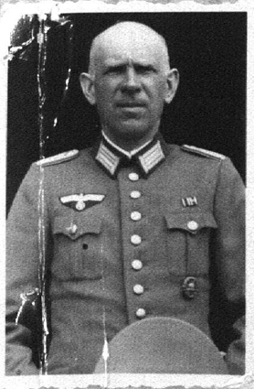
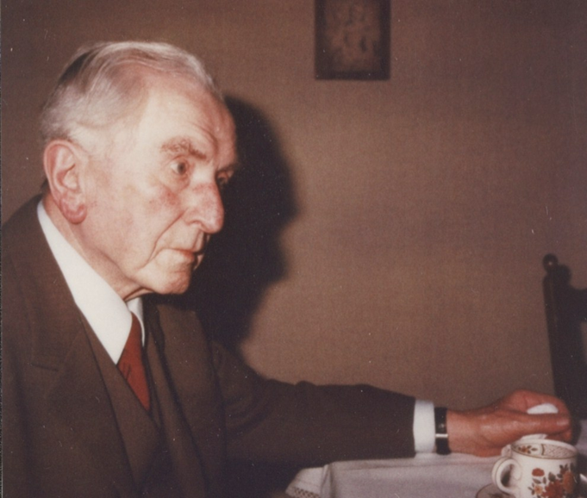
1st BN Commanders
MAJ Alfred Commichau, BN CDR
1LT Josef Sibille,
1st CO
Notes:
On or about 7 October, the 1st BN Commander, MAJ Commichau, ordered his company commanders to kill all the Jews in their AOs. 1LT Kuhls, commander of 2nd Company, complied immediately. Not only was Kuhls an SS member himself, but he was also apparently on e of the two battalion representatives at the Mogilev Conference.
MAJ Commichau apparently telephoned 1LT Sibille directly. According to Sibille, Commichau said “as long as the Jews are not eliminated, we will have any peace from the partisans. The Jewish action in your area must therefore be completed in the end.” Sibille deliberated, and the next day informed Commichau that he would not comply, stating that he could not “expect decent German soldiers to dirty their hands with such things.” Commichau then asked Sibille when he would be hard for once, to which Sibille replied, “in this case, never.” Commichau repeated his order, and Sibille repeated his refusal.
Noll also hesitated to carry out the order, but once it was confirmed in writing, he then asked for volunteers to conduct the executions. Noll then ordered 1SG Zimber to carry out the order.

Slide 14
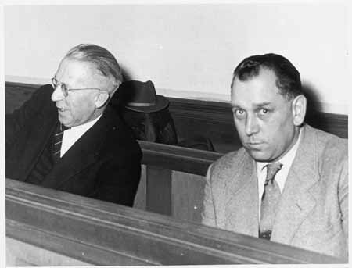
3rd Company Command Team
Nöll & Zimber in the Darmstadt Court

Slide 15
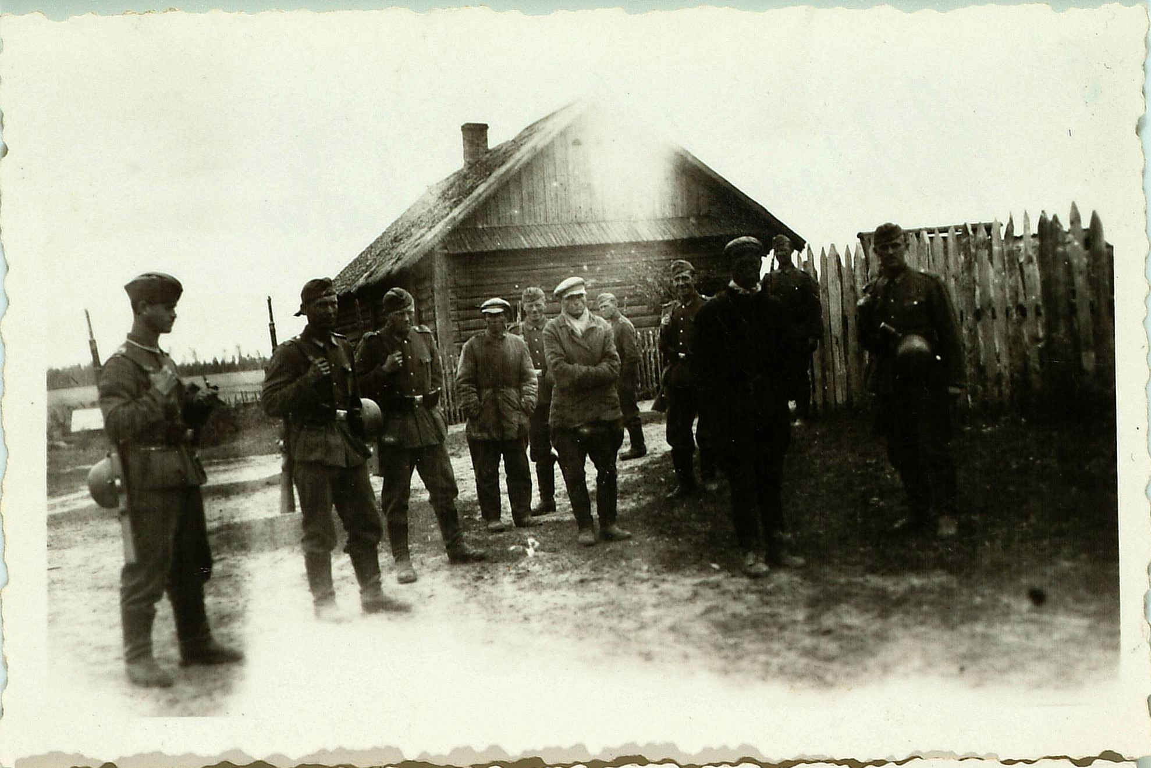
3rd Company
3rd CO leads “Partisans” away
Notes:
1SG Zimber assembled a platoon that had just returned from an overnight mission, and explained their task. The soldiers were apparently indignant , but it is not clear whether they were objected to the task itself or being double-tasked after their mission. Zimber told them “we can’t change anything. Orders are orders.”
Zimber then divided the soldiers into three details, shooting, guarding, and evacuation and cordon. Local police collaborators also assisted.
The evacuation detail began rounding up the Jews in the village, and taking them to a small square where they were temporarily guarded by the second detail.
The shooting detail was located at a site only 200 meters from the village, so the collected civilians could hear the shoots and screams.

