Slide 1
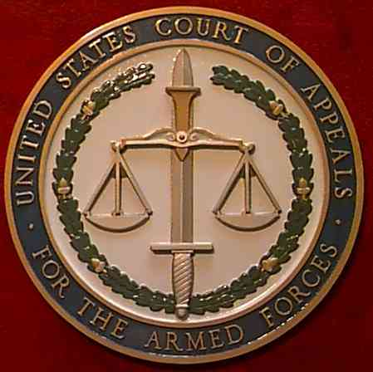
United States Court Of Appeals For The Armed Forces
2016 FULTON CONFERENCE
Appellate Military Judges’
Training Conference
CAAF Update & Frontier Justice
Chief Judge Charles Erdmann
October 5, 2016

Slide 2
United States Court Of Appeals For The Armed Forces
Status at CAAF

Slide 3
United States Court Of Appeals
For The Armed Forces
Statistical Review

Slide 4
Courts-Martial by Year & Branch of Service (General/Special/Summary)
 | 1965 | 1970 | 1975 | 1980 | 1985 | 1990 | 1995 | 2000 | 2005 | 2010 | 2015
AR | 43456 | 58999 | 16278 | 9270 | 4395 | 3493 | 1482 | 1790 | 2777 | 1883 | 1010
N/MC | 24565 | 29988 | 36804 | 15457 | 10735 | 8919 | 4437 | 5142 | 3949 | 2975 | 983
AF | 747 | 396 | 1820 | 1564 | 1511 | 1496 | 1094 | 897 | 1083 | 759 | 524
CG | 327 | 252 | 460 | 239 | 126 | 103 | 33 | 44 | 73 | 41 | 55
Tot. | 69095 | 89635 | 55362 | 26530 | 16767 | 14011 | 7046 | 7873 | 7882 | 5658 | 2572

Slide 5
Courts-Martial by Year & Branch of Service
Notes:
British Article of War – derived from the ancient Roman Articles
1775 Articles – essentially the British Articles – main purpose was to assist the commander in enforcing discipline – it was generally harsh and soldiers and sailors had few rights.
Over the years a few procedural changes were made but it was essentially the 1775 Articles that were in place when WW I started. Rapid expansion of U.S. military – many complaints about the military justice system.
In 1920 additional changes were made affording accused additional rights: the right to be present at trial; the right to present evidence and cross examine witnesses, but it still was a system virtually controlled by the commander from start to finish. No pressure to make more changes – War to end all wars.
WW II – 16 million in military – there were 2 million courts-martial – severe criticism which led to the adoption of the UCMJ in 1950 – which ushered in the modern age of military justice in the U.S.
UCMJ has had several major revisions since its adoption. – Continues to evolve.

Slide 6
Courts-Martial (Not including Summary Courts-Martial)

Slide 7
CCA’s

Slide 8
CAAF Total Petitions Filed Per Year

Slide 9
CAAF Oral Arguments Per Year
Notes:
Before questioning a suspect that servicemenber must be given a rights warning: the offense he is suspected of committing; right to remain silent; if he does say anything it may be used against him at trial; and his right to an attorney. (difference – non-custodial)
Right to Attorney: Regardless of income – military defense attorney provided at no cost. (Different) Also can hire civilian attorney.
Investigation – different levels but for general court martial there must be an Article 32 investigation – (grand jury) More rights. Impartial investigating officer; right to be present; right to be represented; and right to present evidence.
Pre-Trial Confinement – Once ordered into pre-trial confinement by commander that status is reviewed by a ‘neutral and detached magistrate’ to determine whether confinement should be continued or whether the accused should be released.
Discovery: Accused is entitled to virtually everything that the government has in regard to the trial.
Speedy Trial: Accused have speedy trial rights from the consitution, the UCMJ (Art 55) and the Manual for Courts martial. Generally an accused should be brought to trial within 120 days.

Slide 10
CAAF Total Opinions Per Year
Notes:
Administration Actions:
counseling; reprimands; demotion; discharge from service
Article 15 Before the commander
Serves as middle ground between administrative action and courts-martial
Not a trial, no conviction – choice of accused
Considered rehabilitative in nature.

Slide 11
United States Court Of Appeals For The Armed Forces
Selected Issues in
The 2016-2017 Term

Slide 12
United States Court Of Appeals For The Armed Forces
Frontier Justice in
1863 Montana

