Slide 2
The Nuremberg Trials and International Law
William F. Meinecke Jr. National Institute for Holocaust Education October 05, 2016

Slide 3
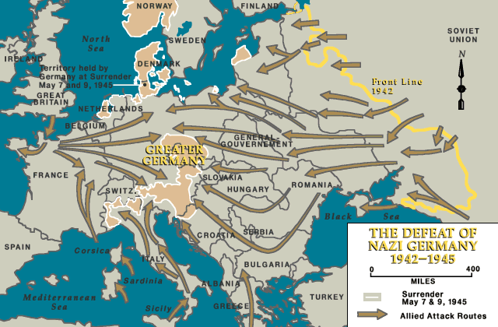
Context for the Trial: The Defeat of Nazi Germany

Slide 4
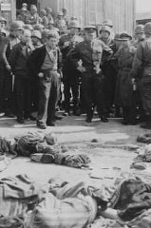
Context for the Trial: Liberation
“The things I saw beggar description...The visual evidence and the verbal testimony of starvation, cruelty and bestiality were... overpowering... I made the visit deliberately in order to be in a position to give first-hand evidence of these things if ever, in the future, there develops a tendency to charge these allegations merely to 'propaganda.' “
General Dwight D. Eisenhower's letter to General George C. Marshall dated April 15, 1945
General Dwight D. Eisenhower (center, right) views the bodies of victims in the Ohrdruf camp, Germany, April 12, 1945.

Slide 5
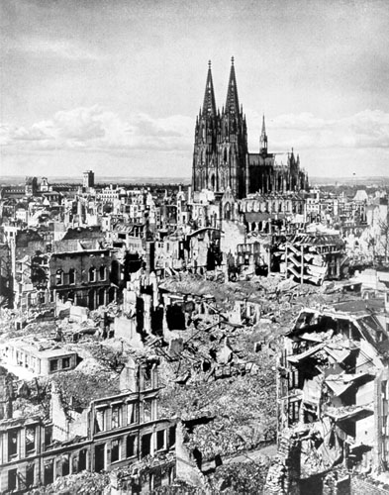
Context for the Trial: Germany in Ruins
View of the destruction of
Cologne, Germany in 1945.
Most German cities suffered major
Damage during World War II.

Slide 6
What should be done about Axis war criminals?
Ignore the whole issue of war criminals
Find and immediately execute accused war criminals
Hold cursory trials --then execute accused war criminals
Hold legitimate trials, requiring specific charges and
evidence with the possibility of “not guilty” verdicts

Slide 7
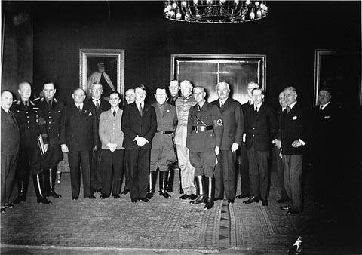
Pre-Trial Issues: Sovereign Immunity
Adolf Hitler poses with members of his new government soon after his appointment as Chancellor. Berlin, Germany, February 1933.

Slide 8
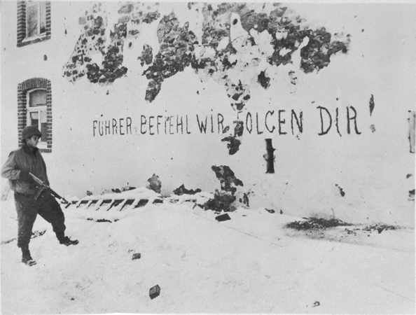
Pre-Trial Issues: Superior Orders
The Führer Orders,
We follow you!
An American soldier poses by a German slogan scrawled on the side of a building during the invasion of Germany, February/April 1945.

Slide 9
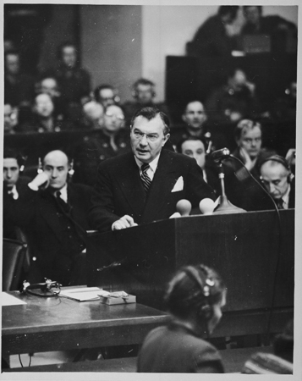
“With the doctrine of immunity of a head of state usually is coupled another, that orders from an official superior protect one who obeys them.
It will be noticed that the combination of these two doctrines means that nobody is responsible.
Society as modernly organized cannot tolerate so broad an area of official irresponsibility.”
Chief U.S. Counsel Justice Robert Jackson delivers the prosecution's opening statement at the International Military Tribunal. Nuremberg, Germany, November 21, 1945.

Slide 10
Charter of the International Military Tribunal
Article 7.
The official position of defendants, whether as Heads of State or responsible officials in Government Departments, shall not be considered as freeing them from responsibility or mitigating punishment.
Article 8.
The fact that the Defendant acted pursuant to order of his Government or of a superior shall not free him from responsibility, but may be considered in mitigation of punishment if the Tribunal determines that justice so requires.
[Nuremberg Trial Proceedings Vol. 1]

Slide 11
Superior Orders Exception:
“the plea of superior orders fails.... when the will of the doer merges with the will of the superior in the execution of the illegal act, the doer may not plead duress under superior orders.
Therefore if a defendant agrees, in principle with an order, he cannot later claim superior orders as a mitigating defense.”
Chief U.S. Counsel Justice Robert Jackson delivers the prosecution's opening statement at the International Military Tribunal. Nuremberg, Germany, November 21, 1945.

Slide 12
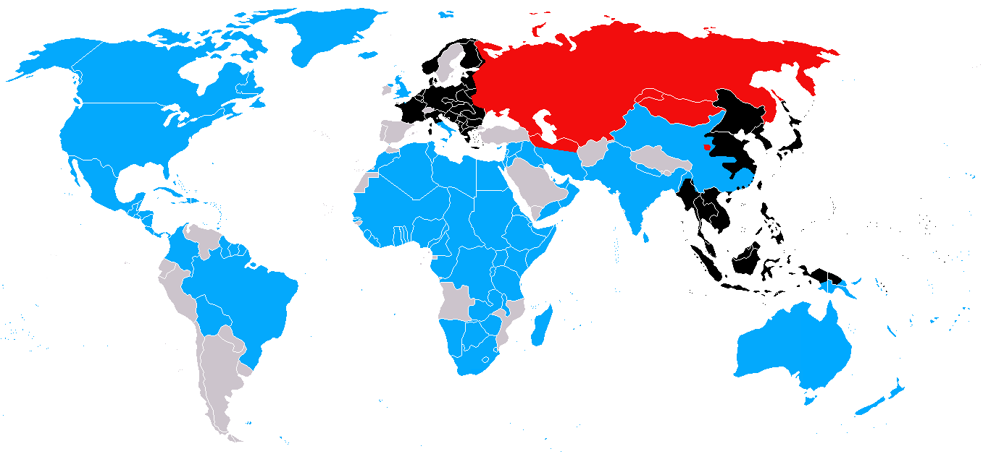
Pre-Trial Issues: Who will try war criminals?
Summer 1944
Black: Axis Controlled ; Blue: Western Allied Control; Red: Soviet Controlled

Slide 13
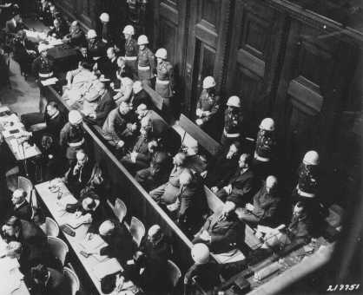
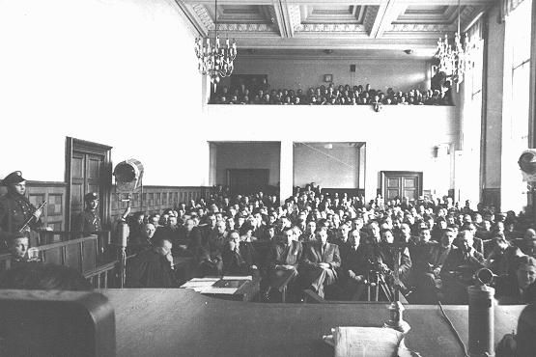
Pre-Trial Issues: Who will try war criminals?
Hans Biebow, German civil administrator of the Lodz ghetto administration, on trial before a national tribunal at Lodz, Poland, 1947.
High-ranking Nazi officials on trial before the
IMT at Nuremberg, Germany, 1945.

Slide 14
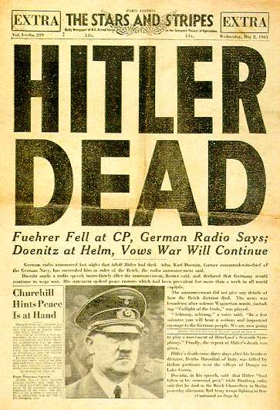
Pre-Trial Issues: Who will face trial?
Hitler: Suicide
Goebbels: Suicide
Himmler: Suicide
Heydrich: Killed by Czech Partisans
Globocnik: Suicide
Stahlecker: killed by Soviet Partisans
Extra Edition of the American military Newspaper STARS AND STRIPES published in Paris, France, May 2, 1945.

Slide 15
Pre-Trial Issues: Who will face trial?
8 million members of the Nazi Party
1.2 million civil servants employed by the Reich
800,000 members of the Waffen-SS
250,000 members of the Order Police
40,000 members of SS Death’s Head Units
32,000 members of the Security Police

Slide 16
Pre-Trial Issues: Who will face trial?
In December 1944, SHAEF ordered the automatic internment of about 200,000 Germans as suspected war criminals including:
Gestapo, SD, Police, Nazi Party and organization officials (30,000),
SS officers (8,000),
Waffen-SS officers (60,000),
SA (officers above rank of Sturmbannfuhrer) (30,000,)
German civilian administrators for occupied territories (about 3,000),
German Reich officials: above rank of city administrator (about 1,500)

Slide 17
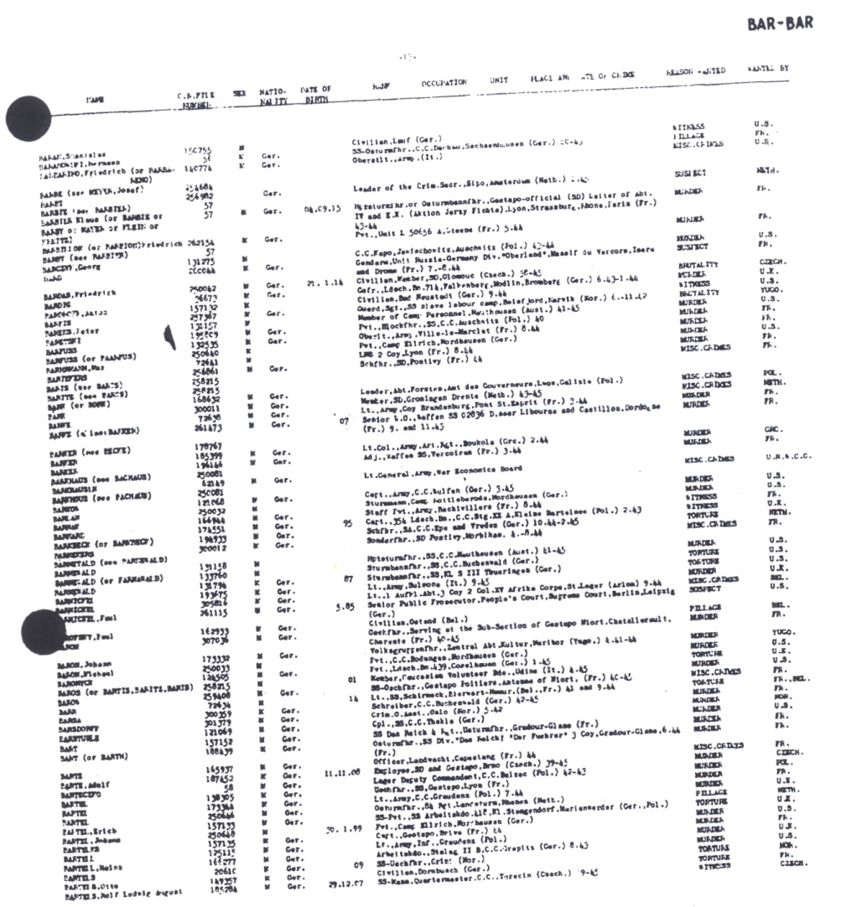
Pre-Trial Issues: Who will face trial?
CROWCASS lists noted the name, nationality, date of birth, case number, occupation, specific crime, date of crime,
place of crime, and the Allied country seeking the tracing and arrest of enemy nationals.
One page from the Central Registry of War Criminals and Security Suspects
(CROWCASS) issued by the Allied Control Authority; 1947 edition. Some 60,000
suspected war criminals were sought for trial after the war.

Slide 18
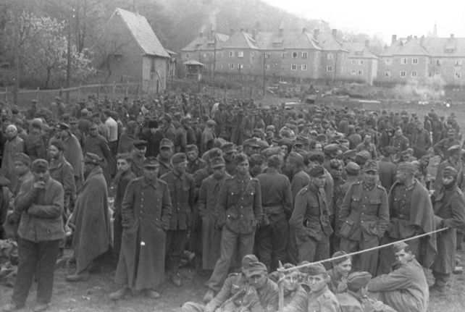
Pre-Trial Issue: Finding Nazi War Criminals
Hundreds of German POWs are imprisoned at a former concentration camp in Germany, 1945.

Slide 19
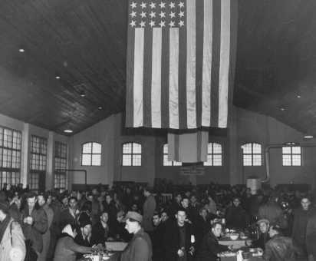
Pre-Trial Issue: Finding Nazi War Criminals
Dining room at the Landsberg displaced persons camp.
Germany, December 6, 1945.

Slide 20
The Defendants:
Occupation Governments:
KONSTANTIN VON NEURATH
ALFRED ROSENBERG
HANS FRANK
ARTHUR SEYSS INQUART
Military:
ERICH RAEDER
KARL DOENITZ
WILHELM KEITEL
ALFRED JODL
Economy:
FRITZ SAUCKEL
ALBERT SPEER
HJALMAR SCHACHT
Nazi State:
HERMANN GOERING
RUDOLF HESS
MARTIN BORMANN
ERNST KALTENBRUNNER:
JOACHIM VON RIBBENTROP
WILHELM FRICK
BALDUR VON SCHIRACH
HANS FRITZSCHE
WALTHER FUNK
JULIUS STREICHER
FRANZ VON PAPEN
Notes:
http://www.ushmm.org/wlc/en/gallery_fi.php?ModuleId=10007069

Slide 21
The Charges:
Count 1: Conspiracy
Count 2: Crimes Against Peace
Count 3: War Crimes
Count 4: Crimes Against Humanity

Slide 22
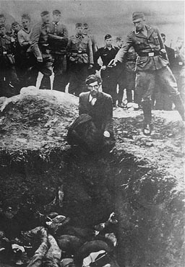
The Charges:
Count 4: Crimes Against Humanity:
“murder, extermination, enslavement, deportation, and other inhumane acts committed against any civilian population, before or during the war; or persecution on political, racial, or religious grounds in execution of or in connection with any crime within the jurisdiction of the tribunal whether or not in violation of domestic law of the country where perpetrated.”
Mass shooting of Jews
Vinnitsa, Soviet Union,
1941-1943

Slide 23
The Charges:
Count 4: Crimes Against Humanity:
“murder, extermination, enslavement, deportation, and other inhumane acts committed against any civilian population, before or during the war; or persecution on political, racial, or religious grounds in execution of or in connection with any crime within the jurisdiction of the tribunal whether or not in violation of domestic law of the country where perpetrated.”
Mass shooting of Jews
Vinnitsa, Soviet Union,
1941-1943

Slide 24
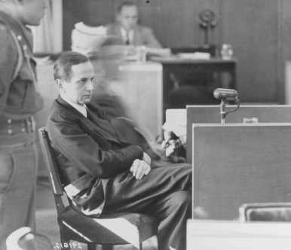
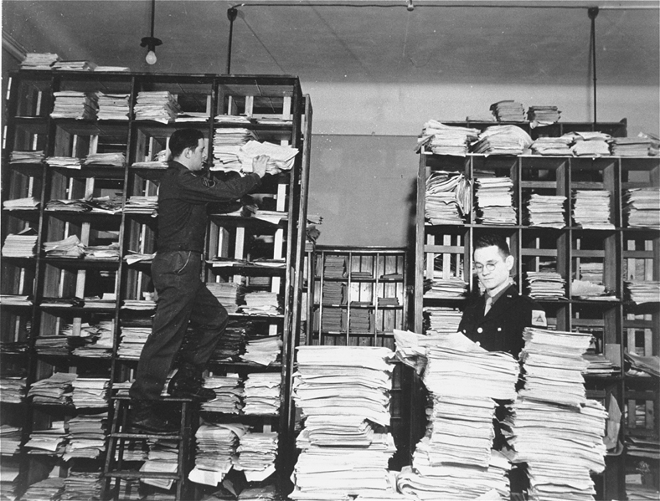
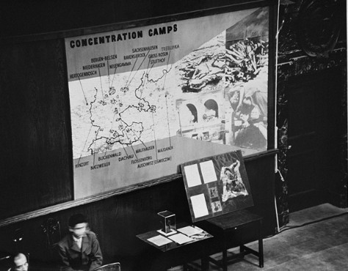
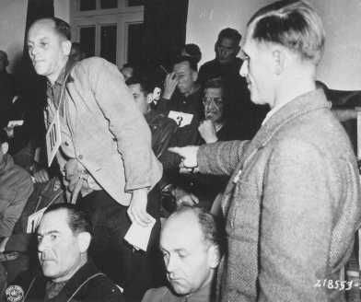
The Evidence:
Testimony / Affidavits from
1,000s of German officials
3000 tons of documents
“We must establish incredible events by credible evidence.” —U.S. Chief Prosecutor Robert Jackson, June 7, 1945.
Photographs, Maps, Film
Survivor Testimony / Affidavits

Slide 25
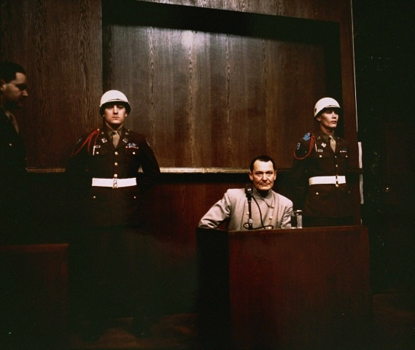
Goering: “… I hereby empower you to make an overall plan of the organizational, functional, and material measures to be taken in preparing for the implementation--and now we come to the decisive word, which has been falsely translated--it states here, namely, for a complete solution, not for a final solution, for a complete solution of the Jewish question in the entire German sphere of influence in Europe."
Field Marshall Herman Goering
testifies at his trial for war crimes Nuremberg, Germany, March 1, 1946.
Notes:
http://www.ushmm.org/wlc/en/gallery_fi.php?ModuleId=10007069
Date: Friday, March 01, 1946 Locale: Nuremberg, [Bavaria] Germany Credit: National Archives and Records Administration, College Park Copyright: Public Domain Hermann Goering testifies from the witness box at the International Military Tribunal trial of war criminals at Nuremberg.

Slide 26
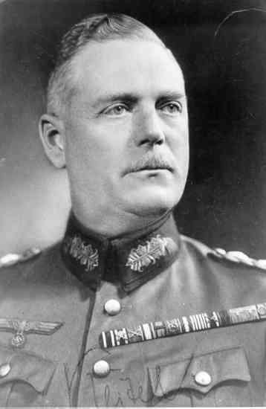
[American Prosecutor] MR. DODD: You told us that some of these orders were violations of the existing international law. An order issued in that form and on that basis is a criminal order, is an illegal order, is it not?
KEITEL: Yes, that is correct.
MR. DODD: Well, when you carried them out, you were carrying out criminal orders in violation of one of the basic principles of your professional soldier's code, no matter by whom they were issued.
KEITEL: Yes.
(Nuremberg Trial Proceedings Vol. 11
Monday, 8 April 1946 from Avalon project at http://www.yale.edu/lawweb/avalon/imt/proc/04-08-46.htm)
General Field Marshal
Wilhelm Keitel (OKW)

Slide 27
The Verdicts:
Life in Prison:
RUDOLF HESS
ERICH RAEDER
WALTHER FUNK
Prison Terms:
KARL DOENITZ: 10 Years
KONSTANTIN VON NEURATH: 15 Years
BALDUR VON SCHIRACH 20 years
ALBERT SPEER: 20 Years
Not Guilty:
FRANZ VON PAPEN
HJALMAR SCHACHT
HANS FRITZSCHE
Death by Hanging:
HERMANN GOERING
JOACHIM VON RIBBENTROP
WILHELM KEITEL
ALFRED JODL
ALFRED ROSENBERG
WILHELM FRICK
ERNST KALTENBRUNNER
HANS FRANK
JULIUS STREICHER
FRITZ SAUCKEL
ARTHUR SEYSS INQUART
MARTIN BORMANN:(Absentia)

Slide 28
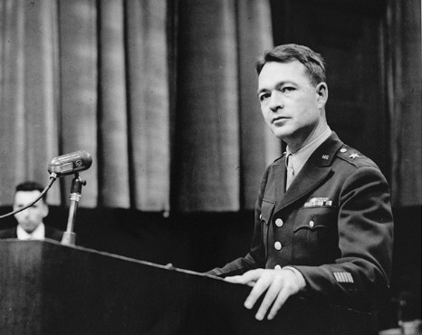
The 12 subsequent trials were:
Case #1, The Medical Case;
Case #2, The Milch Case;
Case #3, The Justice Case;
Case #4, The Pohl Case;
Case #5, The Flick Case;
Case #6, The I.G. Farben Case;
Case #7, The Hostage Case;
Case #8, The RuSHA Case;
Case #9, The Einsatzgruppen Case;
Case #10, The Krupp Case;
Case #11, The Ministries Case;
Case #12, The High Command Case.
Brigadier General Telford Taylor, Chief of Counsel, during the Medical Case. Nuremberg, Germany, 1946-1947.

Slide 29
Precedents Established at Nuremberg:
Outlawed wars of aggression
Permitted the trial of members of government
Limited the “Superior Orders” defense
These principles incorporated into:
Genocide Convention 1948
Human Rights Declaration 1948
Geneva Convention on laws and customs of war 1949

Slide 30
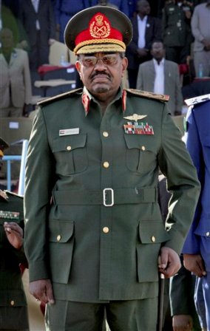
On March 4, 2009, the International Criminal Court issued an arrest warrant against Sudanese President Omar al-Bashir for crimes against humanity and war crimes committed by government forces and Arab militias in the Darfur region of Sudan.
President Omar al-Bashir of Sudan

